Slide 1
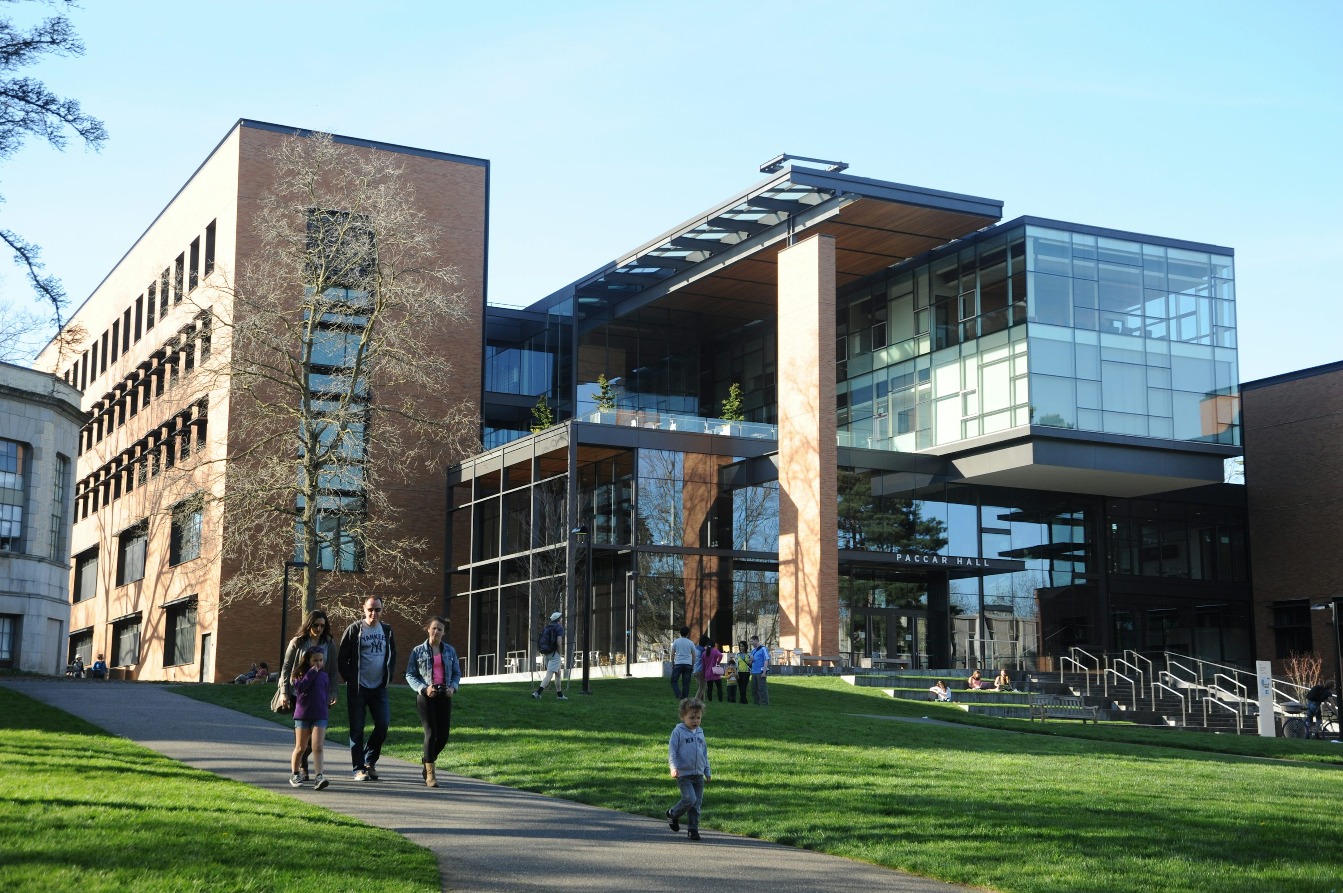
HW03 校園故事
Notes:
圖片: https://unsplash.com/photos/people-walking-near-paccar-hall-university-of-washington-during-daytime-6zlgM-GUd6I

Slide 2

1. 目標
Notes:
圖片: https://unsplash.com/photos/white-and-black-hearts-illustration-eo5Hrzyb4D0

Slide 3
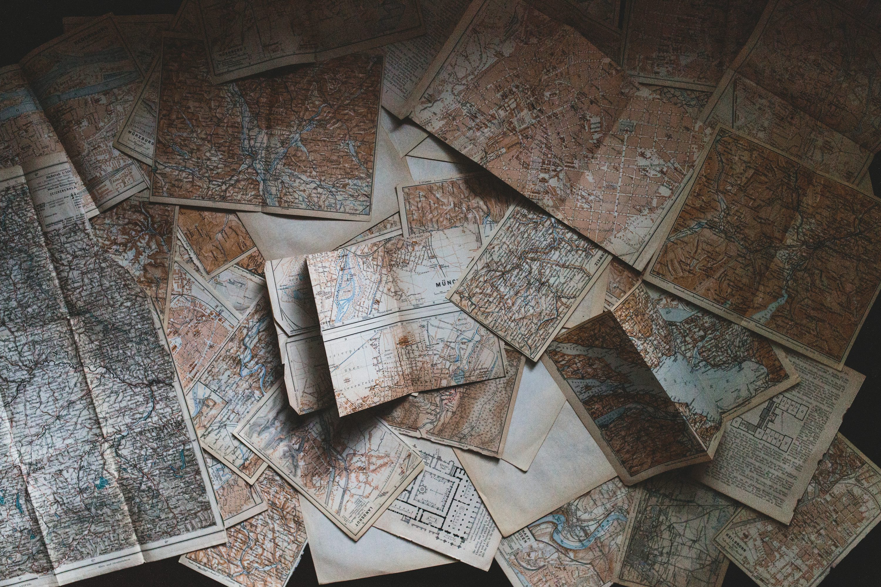
2. 阻礙
Notes:
圖片: https://unsplash.com/photos/maps-lying-on-the-floor-1-29wyvvLJA

Slide 4

3. 努力
Notes:
圖片: https://unsplash.com/photos/photo-of-bulb-artwork-82TpEld0_e4

Slide 5

4. 結果
Notes:
圖片: https://unsplash.com/photos/grayscale-photo-of-person-holding-glass-Iq9SaJezkOE

Slide 6

5. 意外
Notes:
圖片: https://unsplash.com/photos/stainless-steel-plates-0BhSKStVtdM

Slide 7

6. 轉折
Notes:
圖片: https://unsplash.com/photos/a-group-of-people-sitting-around-a-table-W3RqrBgKEro

Slide 8
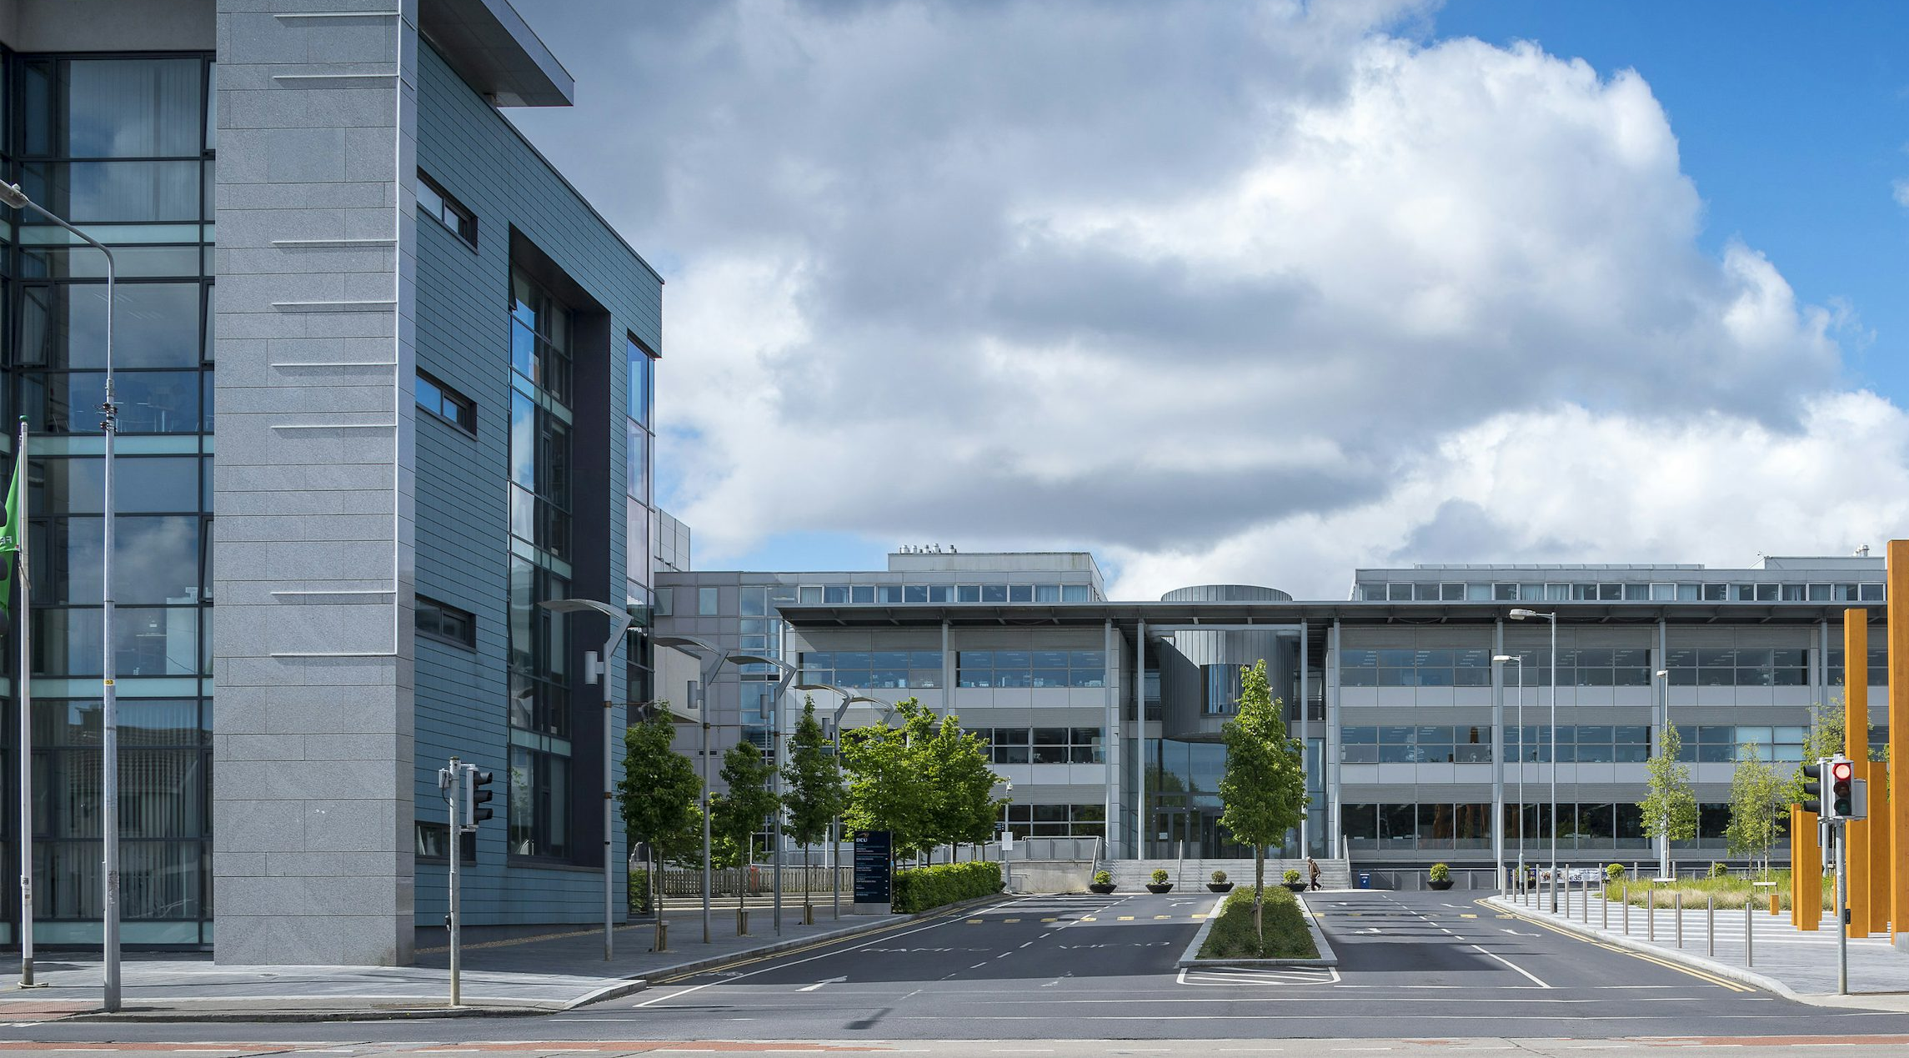
7. 結局
Notes:
圖片: https://unsplash.com/photos/gray-concrete-building-under-blue-sky-during-daytime-k60YOEjB75k

